Slide 1
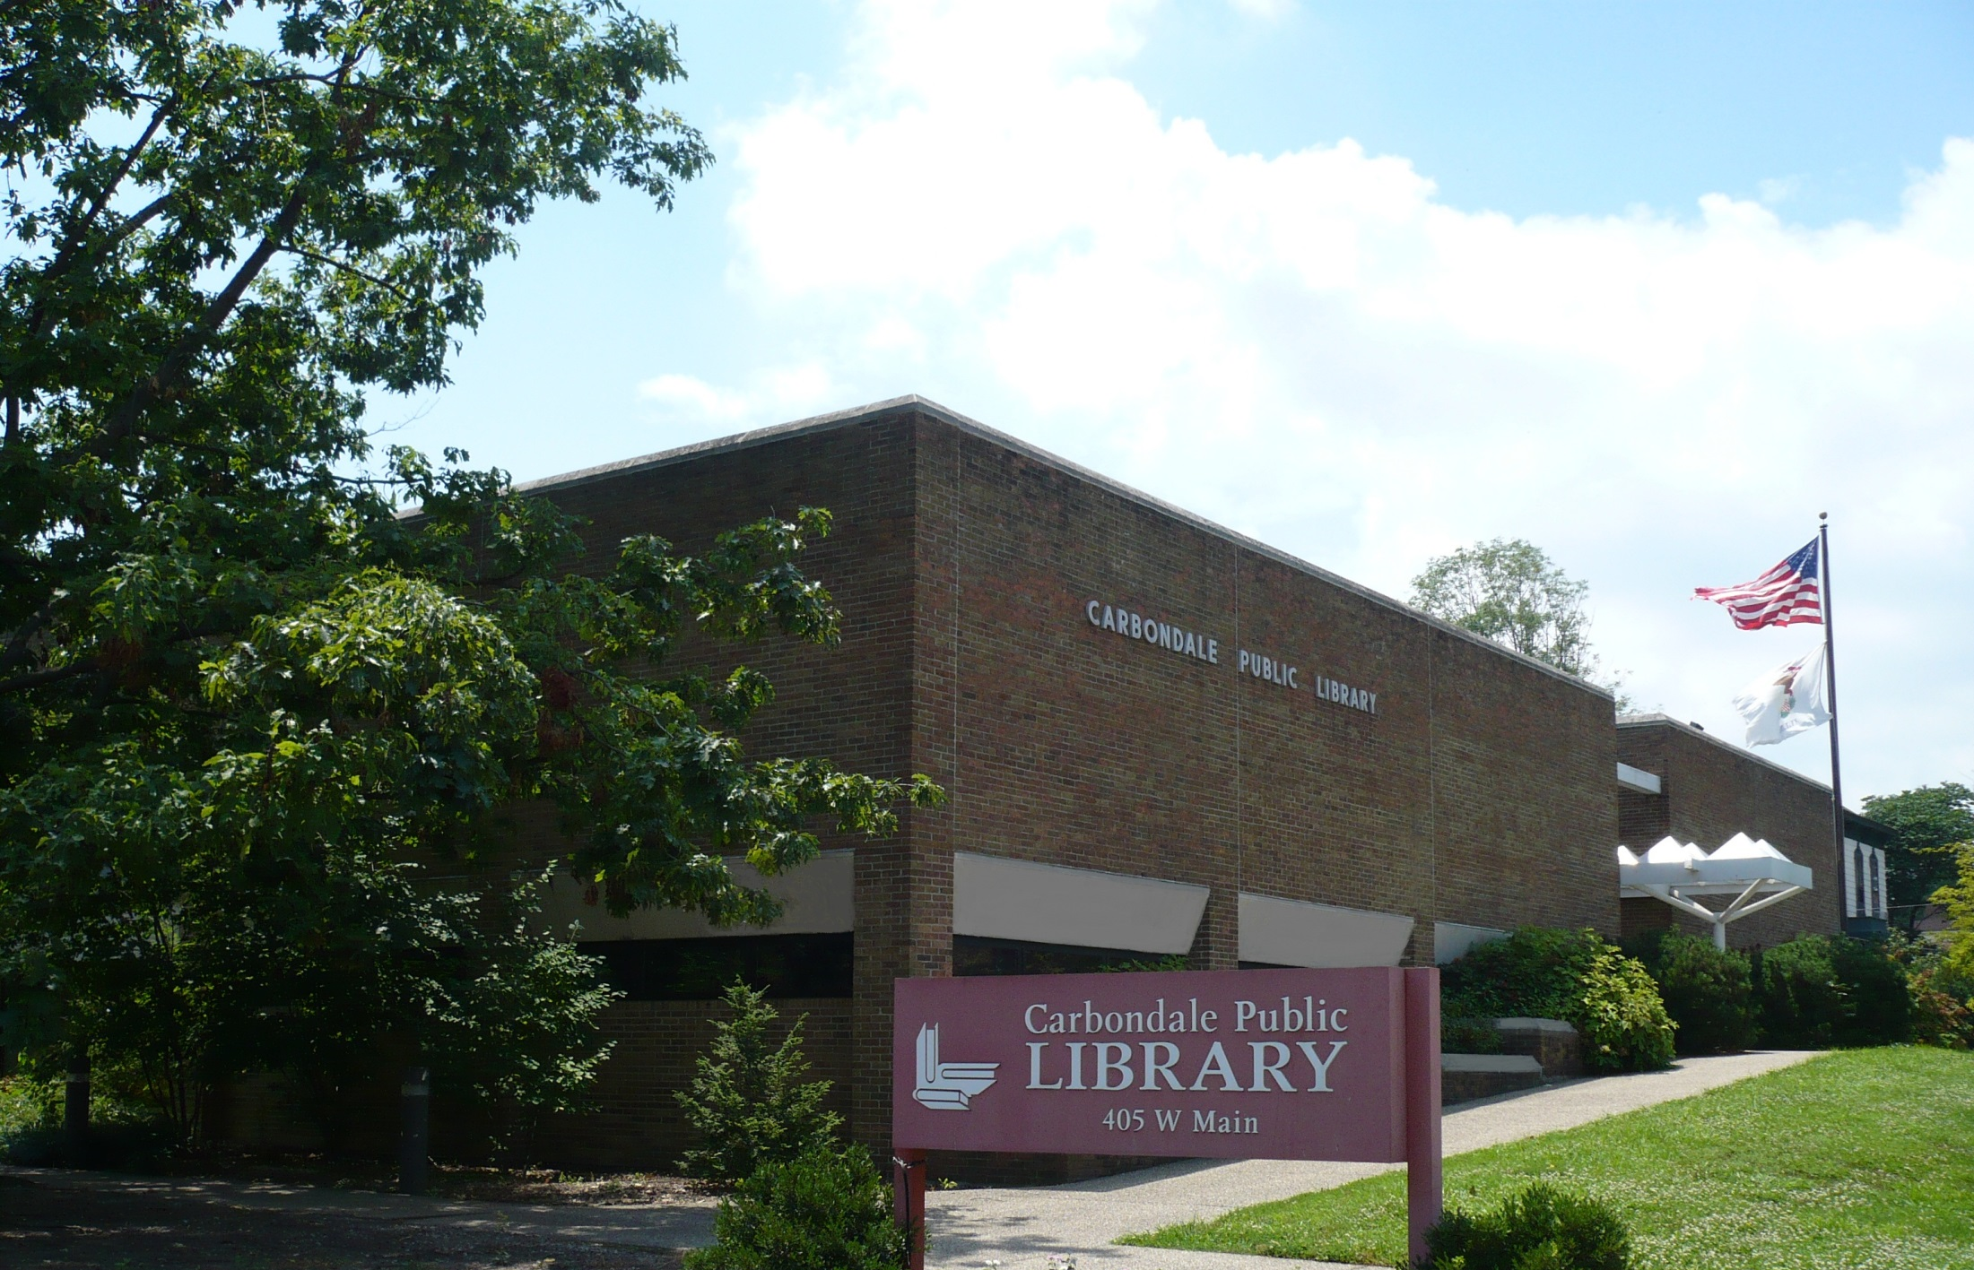
Public Libraries as
Community Development Partners
Downstate City/County Management Association
Southwestern Illinois City Management Association
August 9, 2019
Diana Brawley Sussman, Director
Carbondale Public Library

Slide 2

Libraries identify community needs and serve those needs. This happens within the library’s mission, but not always within the library’s walls.

Slide 3
“Great libraries build communities.”
― R. David Lankes
Expect More: Demanding Better Libraries For Today's Complex World

Slide 4
As of January 2018, Illinois had an estimated 10,643 experiencing homelessness on any given day, as reported by Continuums of Care to the U.S. Department of Housing and Urban Development (HUD). Of that Total, 1,223 were family households, 804 were Veterans, 684 were unaccompanied young adults (aged 18-24), and 1,625 were individuals experiencing chronic homelessness.
Public school data reported to the U.S. Department of Education during the 2016-2017 school year shows that an estimated 50,949 public school students experienced homelessness over the course of the year. Of that total, 447 students were unsheltered, 5,674 were in shelters, 1,795 were in hotels/motels, and 42,223 were doubled up.
United States Interagency Council on Homelessness
Slide provided Leander Spearman, Director
BellevillePublic Library

Slide 5
Types of Homelessness
Chronic Homelessness
Individuals who have been continuously homeless for a year or more, or has had a minimum of four episodes of homelessness in the previous three years
Episodic Homelessness
Individuals who are currently homeless and have experienced at least 3 periods of homelessness in the previous year
Transitional Homelessness
Individuals residing in shelters, temporary housing or extended stay hotels for short periods of time
Provisionally Occupied
Individuals living with friends or family members with no long-term guarantee of continued housing, “couch suffers”
Slide provided Leander Spearman, Director
BellevillePublic Library

Slide 6
What Causes Homelessness?
Lack of affordable housing
Lack of Income
Health condition
Domestic Abuse
Racial Disparities
“A Series of Unfortunate Events”
Slide provided Leander Spearman, Director
BellevillePublic Library

Slide 7
Social Workers

Slide 8
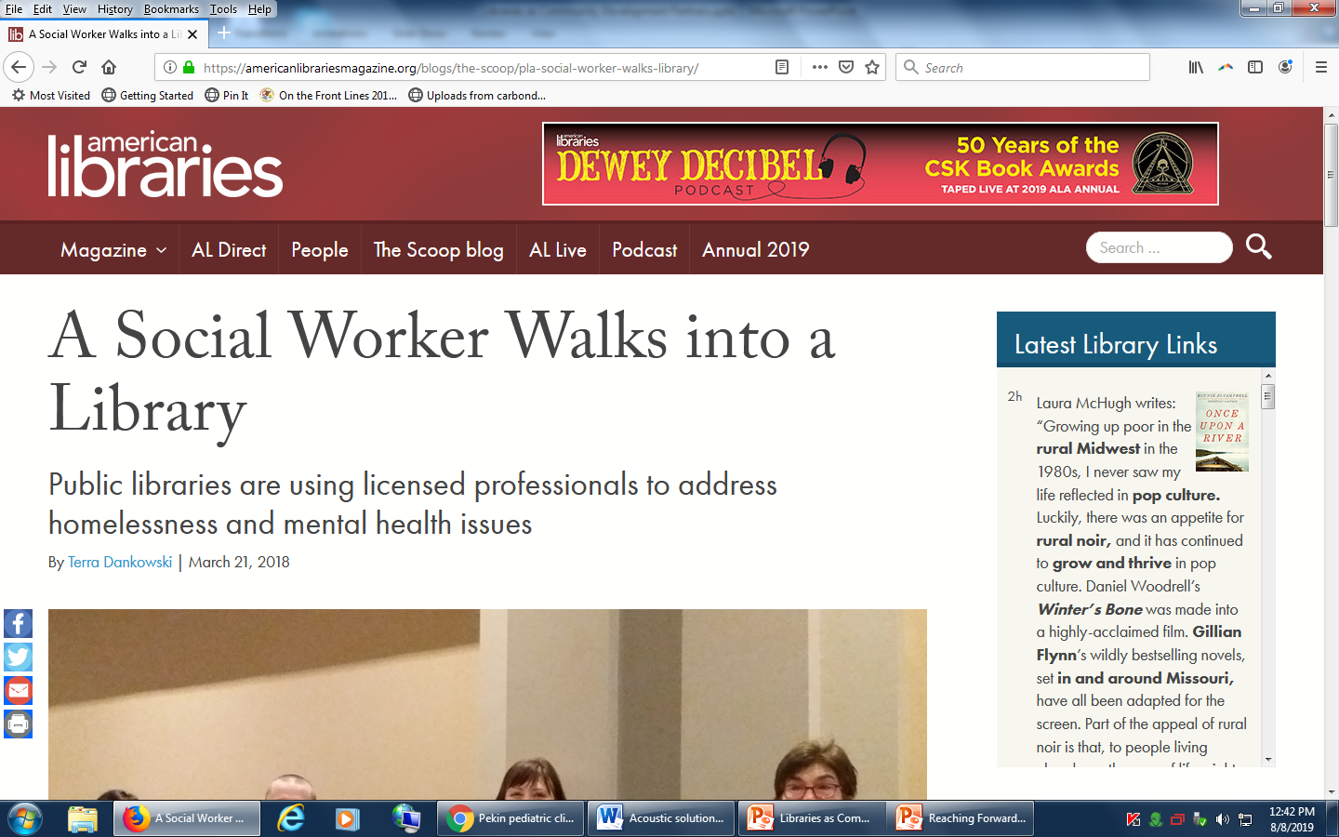
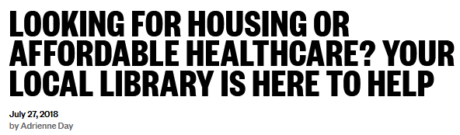
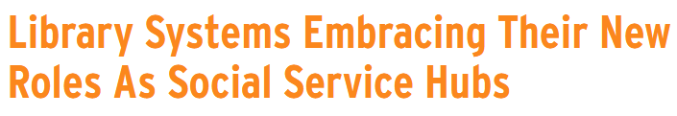
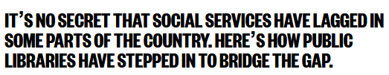
Launched in San Francisco, 2009:
Sources: https://americanlibrariesmagazine.org/blogs/the-scoop/pla-social-worker-walks-library/
http://nationswell.com/library-social-services/
https://nextcity.org/daily/entry/library-systems-embracing-their-new-roles-as-social-service-hubs

Slide 9
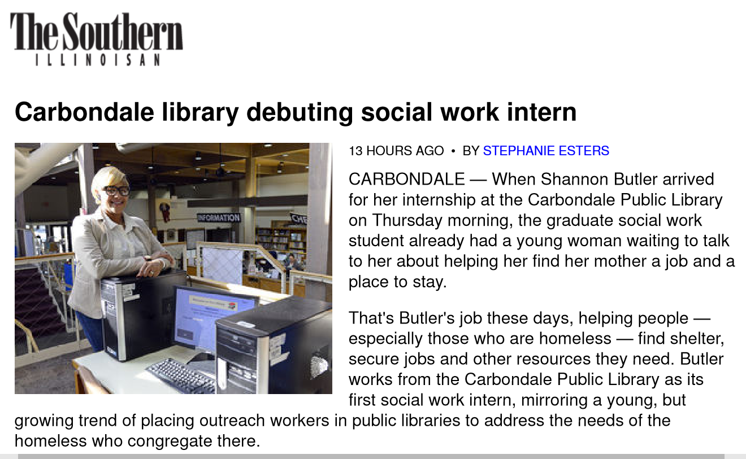
Offered in Carbondale since 2015: ness and poverty in Southern Illinois. sparrowcoalition.org
Notes:
Read the slide.

Slide 10
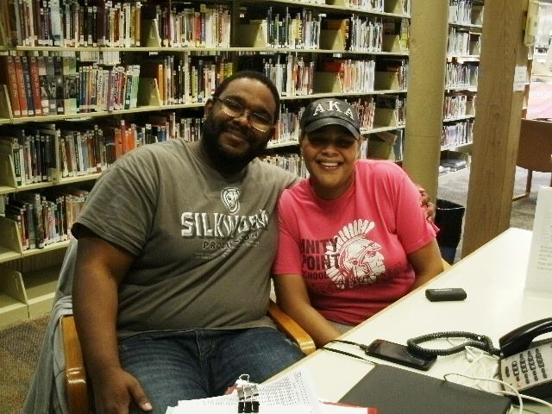
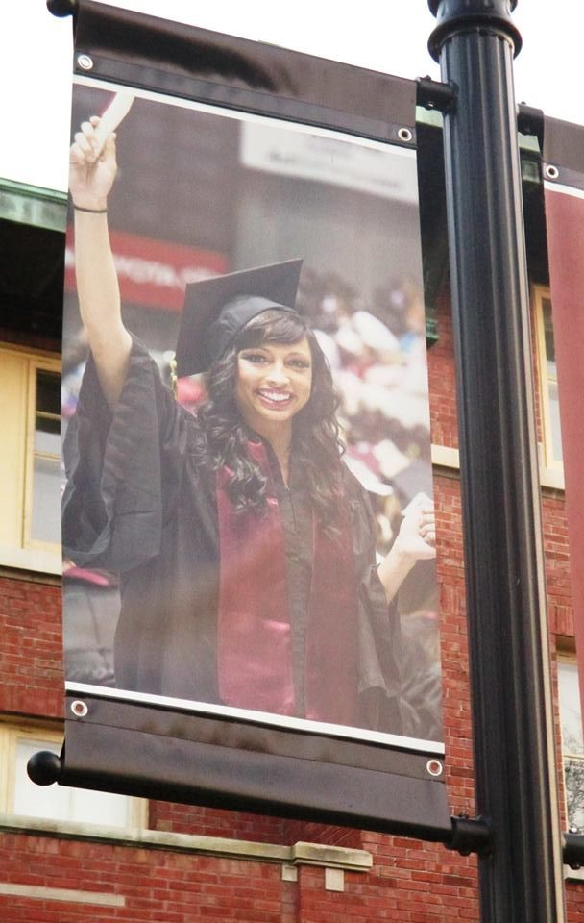
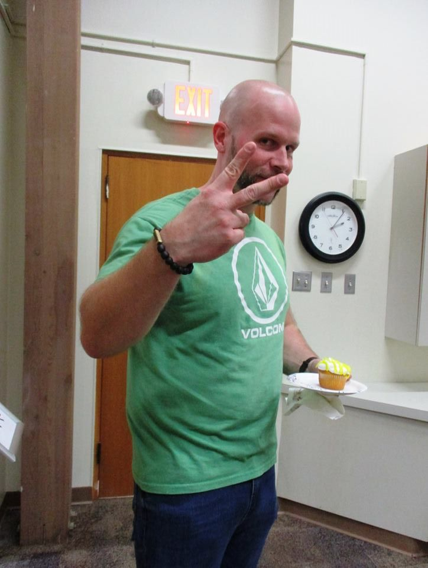
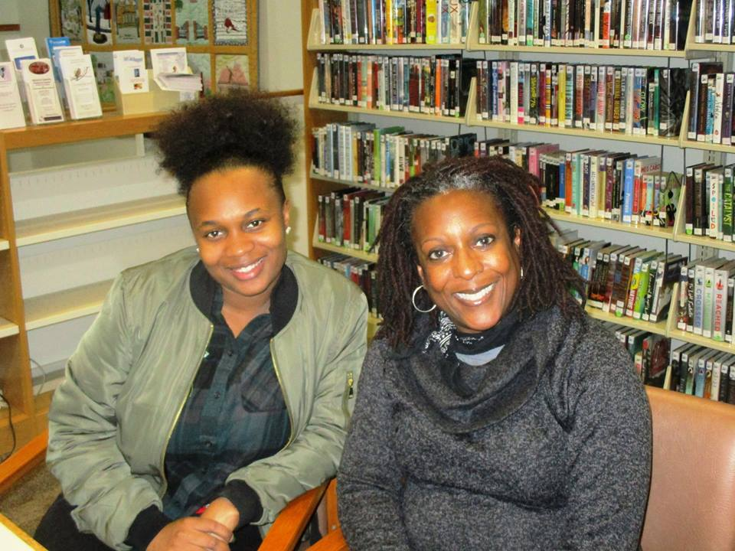
Carbondale Public Library
Social Work Interns
2015-2019
Interns serve
60+ patrons
each school
year.
Most service
needs are
related to
housing,
bill-pay, jobs, or
transportation.

Slide 11
Models for Providing Social Work in Libraries:
Interns: Unpaid students, minimal cost, in partnership with a university, university pays malpractice insurance, annual turnover, learning curve, service gaps between semesters (Carbondale Public Library)
Partner agencies: Outside service providers work inside the library a certain number of hours each week, minimal cost, partner agency pays malpractice insurance, level and type of service must be negotiated (San Diego Public Library)
Paid social worker(s) on staff: Personnel and insurance costs incurred by library, consistent long-term service provision, level and type of service determined by library, may supplement or replace security guards (Oak Park Public Library, San Francisco Public Library)

Slide 12
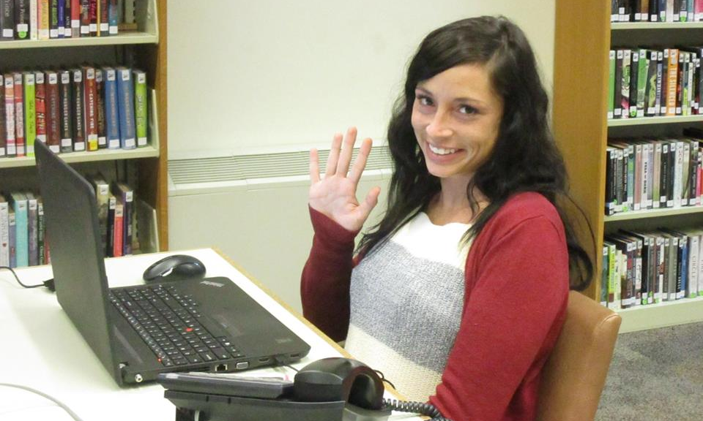
Carbondale Public Library Social Work Interns are:
Volunteers
Stationed in the library 14-20 hours per week
Serving 2 semesters (9 months)
Completing the MSW program at SIU
Supervised by a licensed social worker 1 hour per week
Stationed at a table in the library
Learning about area services through outreach
Educating library staff
about area services
Expanding the library’s
information services
Covered for malpractice
by SIU

Slide 13
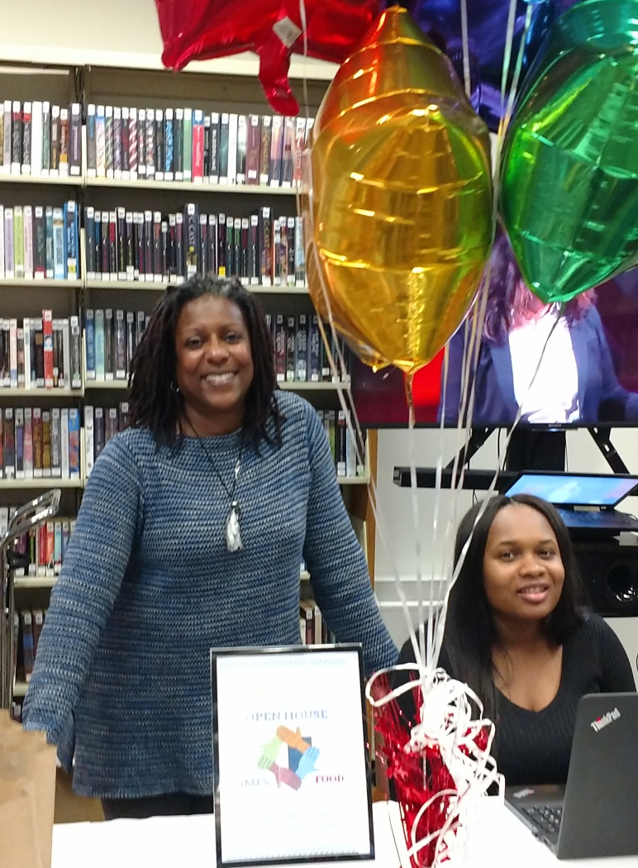
MSW Social Work Interns provide:
Case management
Needs Assessment
Resource referrals for housing, employment, medical services, food banks, child care, public aid
Assistance with employment and education
applications
Advocacy for individuals
Vetting of client applications for emergency
funds from area churches to verify need
Supplementary programming such as coat
drives and job fairs

Slide 14

Associated costs (per intern):
$50/week ($2,600 /year) for licensed self-insured social worker to provide 1 hour/week supervision
SIU requires specific general Liability insurance coverage (already held by the library)
Portable office: Laptop, phone, lockable file box, general supplies
Honorarium awarded upon graduation ($300 per semester)

Slide 15
Sample Social Work Documents
Available Upon Request
- Library intern contract with SIU
- Social work field placement duties
Manual for social work interns
(created and maintained by the interns)
Carbondale Cares Emergency Fund Application
To request documents:
Email Diana Brawley Sussman, Director
Carbondale Public Library
dbrawley@carbondale.lib.il.us
618-457-0354, ext. 9

Slide 16
Challenges We Face & Solutions We’re Trying:
Challenge: It is difficult for interns to cultivate a comprehensive
awareness of area resources, which fluctuate as funding shifts
Solutions:
Concentrate on making referrals
Make outreach calls to service providers
Interns created and maintain a manual
Implement orientation training from an area service provider
Join the Continuum of Care and attend meetings
http://www.sicocn.org/

Slide 17
Challenges We Face & Solutions We’re Trying:
Challenge: Patrons often have unmet financial needs
(beyond information needs)
Solutions:
Develop a clear understanding of available services and
service gaps
Work with area churches or organizations to identify or develop a fund to meet service gaps
Assist the fund holder with developing a service application
Use the application to verify that a patron’s need is legitimate and cannot be met by other existing resources
Work with the funder to provide fund awareness and access through other area service providers as well
Be prepared to say no. Not all needs can be met

Slide 18
Challenges We Face & Solutions We’re Trying:
Challenge: Some homeless residents could not be served by area shelters. This may be due to challenging behaviors, overcrowding, admittance policies, or other factors. During inclement weather, this endangers their lives.
Solution: In the winter of 2019, Carbondale opened a temporary warming center.
Who: The Carbondale Warming Center Committee is comprised of local organizations, including the Southern Illinois Coalition for the Homeless, Good Samaritan, Carbondale Interfaith Council, Jackson County Health Department, Centerstone, Sparrow Coalition, the SIU Clinical Center, Carbondale Public Library, the City of Carbondale, as well as other organizations and individuals.

Slide 19
Warming Center

Slide 20
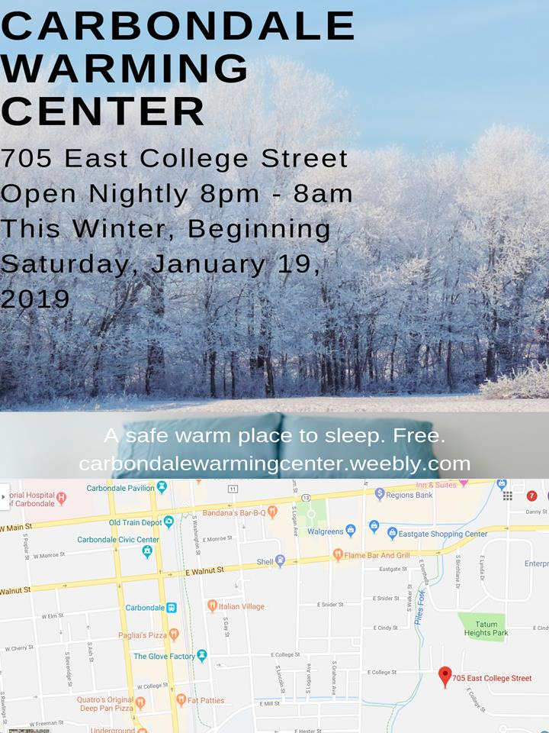
Mission: To provide nighttime sleeping space on cold nights as a supplement to Carbondale's existing shelter system, for the sake of human dignity, safety, and survival.
Funded by: Donations from 75 individuals, organizations, businesses, and churches.

Slide 21
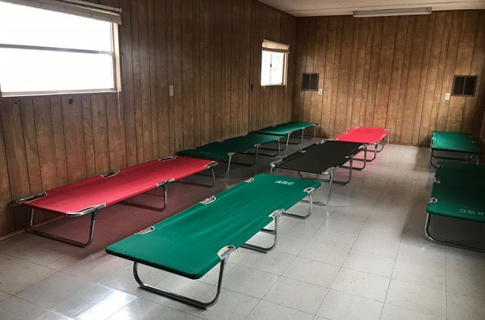
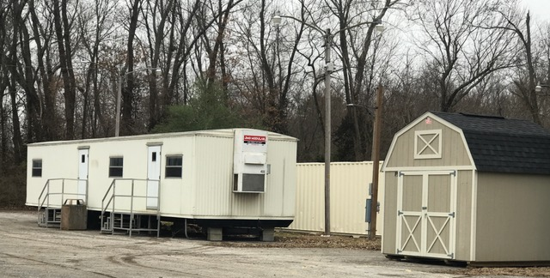
Carbondale Warming Center 2019 Statistics
- 57 overnight guests (20 women)
- 618 stays over 72 nights
- An average of 8.6 persons per night (15 maximum, 3 minimum)
- An average of 10.8 stays per person
- 5 paid staff (including the Coordinator)
- 2 SIU School of Social Work Interns
- 17 volunteers

Slide 22
Carbondale Warming Center Budget
Income:
$27,810.00 through community grants and donations
$5,539.00 through a Southern Illinois Coalition for the Homeless and Department of Human Services Outreach Grant
Total Income: $33,349.00
Expenses:
Staff: $19,968.00
Equipment rental and delivery (temporary buildings, porta-potties, hand washing station): $3,734.00
Insurance: $690.00
Telephone, Maintenance, Laundry, Supplies: $1,633.00
Total Expenses: $26,025.00
Net Income: $7,324.00

Slide 23
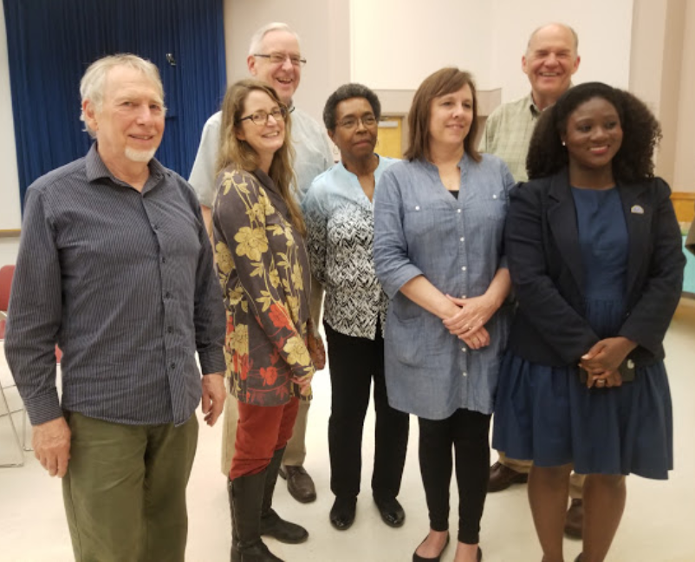
Carbondale Warming Center Committee
Project
implementation
required participation
and administrative
support from the city,
police, and direct
service agencies.
A few members of the Warming Center Committee: Roger Webb (Sparrow Coalition),
Diana Brawley Sussman (library), Mike Henry (Mayor), Carolin Harvey (City Council),
Camille Dorris (Southern Illinois Coalition for the Homeless), Scott Martin (Interfaith Council),
Kamille Gutherie (Warming Center Coordinator)

Slide 24
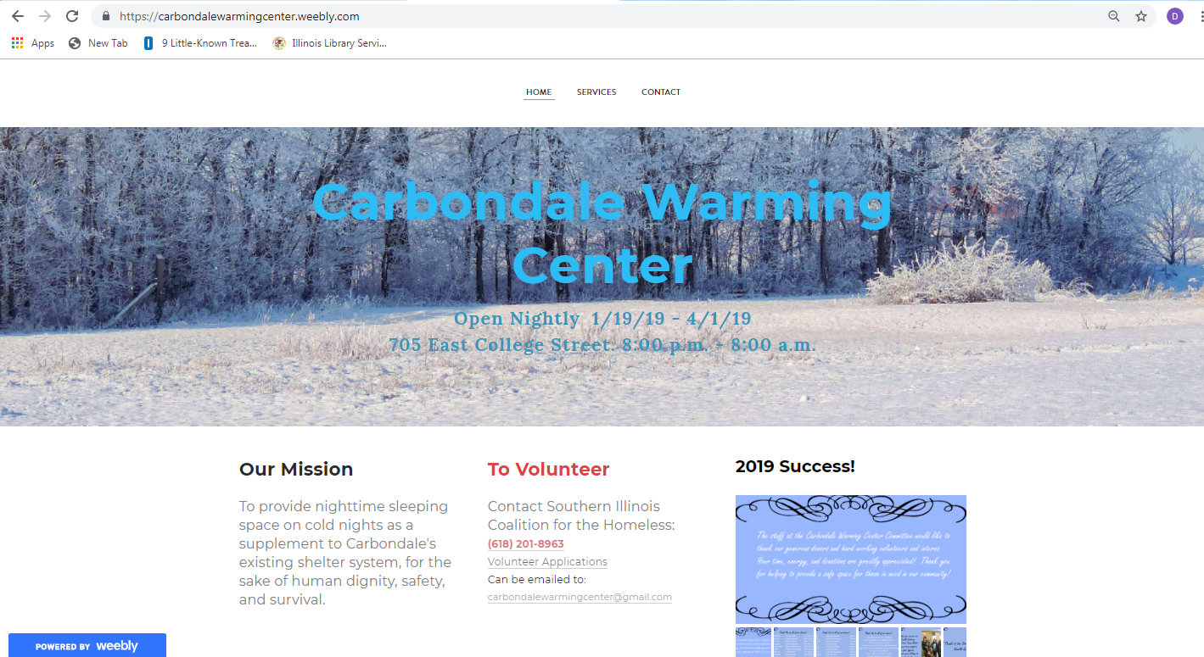
The Library’s Role in the Warming Center
Served on the Warming Center Committee
Created the center’s preliminary budget
Created the center’s website
Helped to advocated with press and City Council
Marketed services to people in need
carbondalewarmingcenter.weebly.com

Slide 25
Programs and Pantries

Slide 26
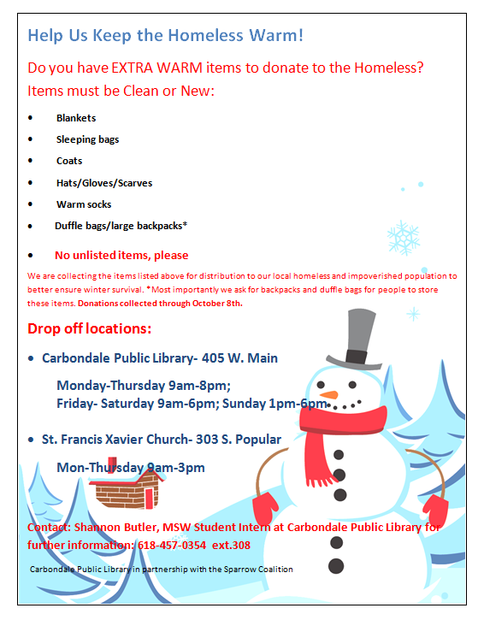
Item Drives:
Be Specific:
What items are needed?
In what condition?
What items are NOT needed?
Where to drop off items?
When?
For what purpose?

Slide 27
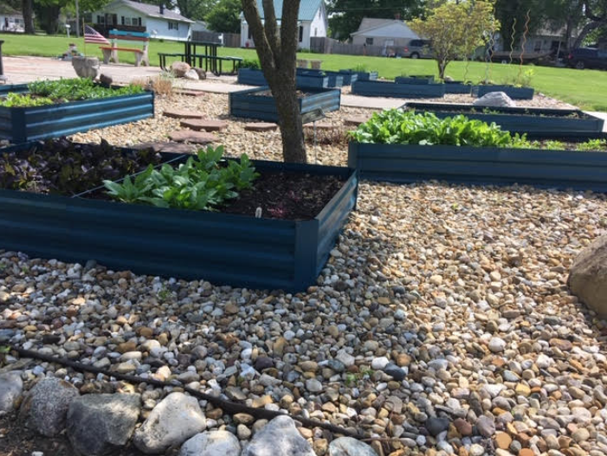
Community Garden at Maroa Public Library

Slide 28
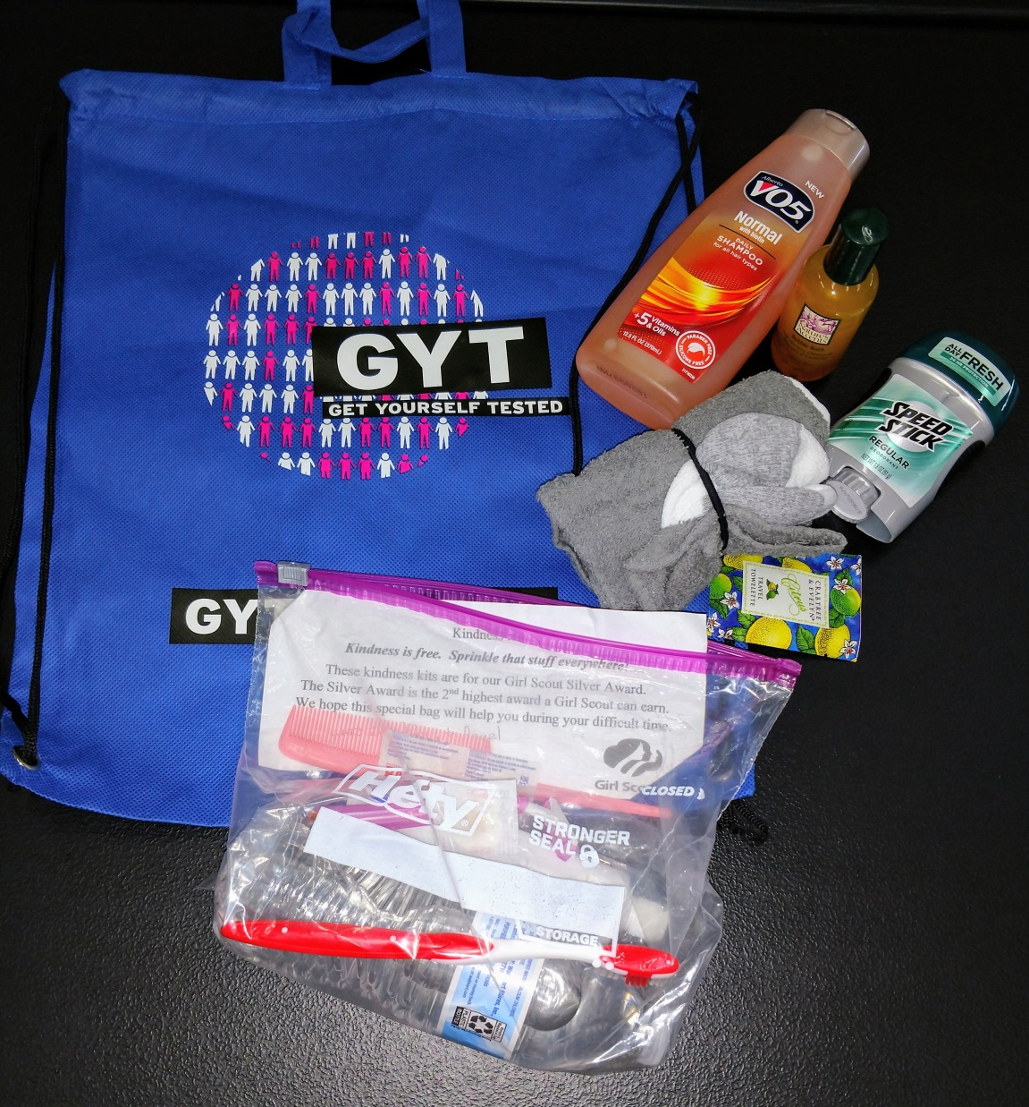
Hygiene bags
ADULT SOCKS
STOCKING CAPS
GLOVES
HAND SANITIZER
DEODORANT
SMALL COMBS
DISPOSABLE RAZORS
LIP BALM
HAND LOTION
SOAP or BODY WASH
WET ONES/WIPES or WASH CLOTHS
SHAMPOO
CONDITIONER
TOOTHBRUSH
TOOTH PASTE
TAMPONS/PADS
PROTEIN BARS
DRIED FRUIT SNACKS/raisins
LG ZIPLOCK BAGS (GALLON SIZE)
- Most helpful are disposable, travel size and snack size

Slide 29
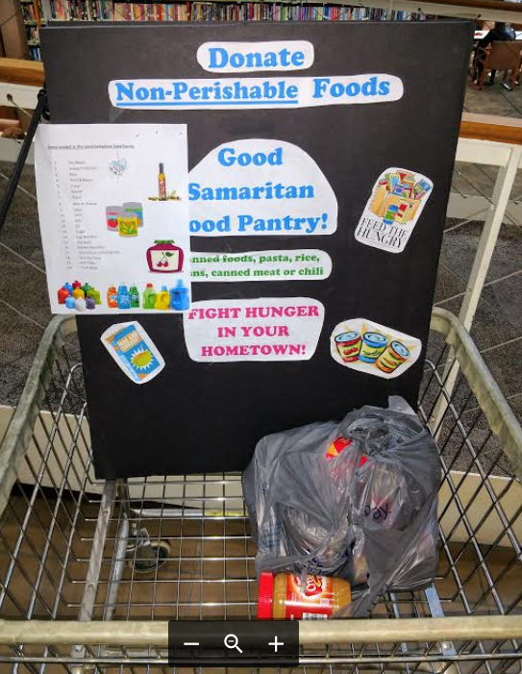
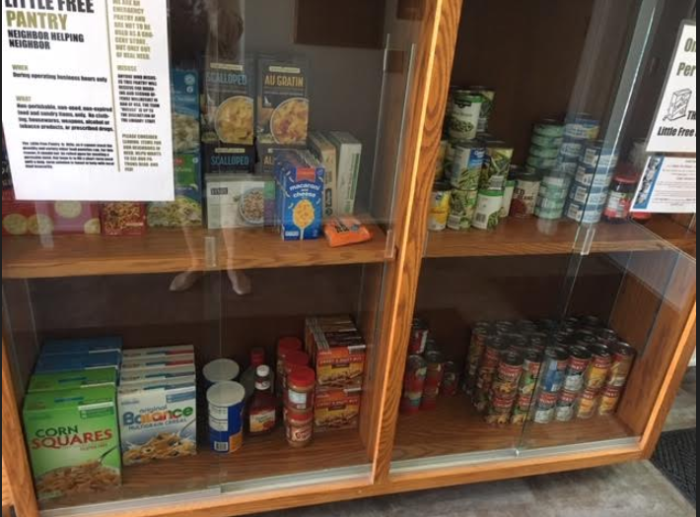

Pantries
Maroa Public Library:
Little Free Pantry in trophy case. Patrons donate; take 1 bag per week.
Carbondale
Public
Library:
Ongoing
donation
basket
Vespian Warner Public Library District:
Seasonal Garden Table: gardeners share extra produce

Slide 30
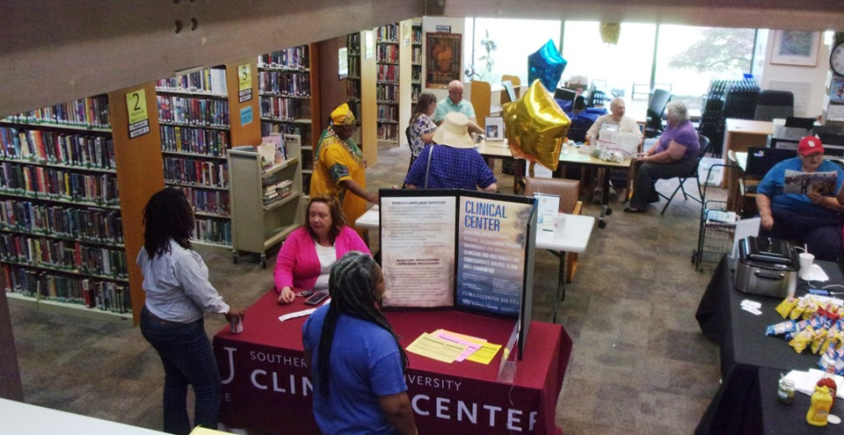
Community Resource Fair

Slide 31
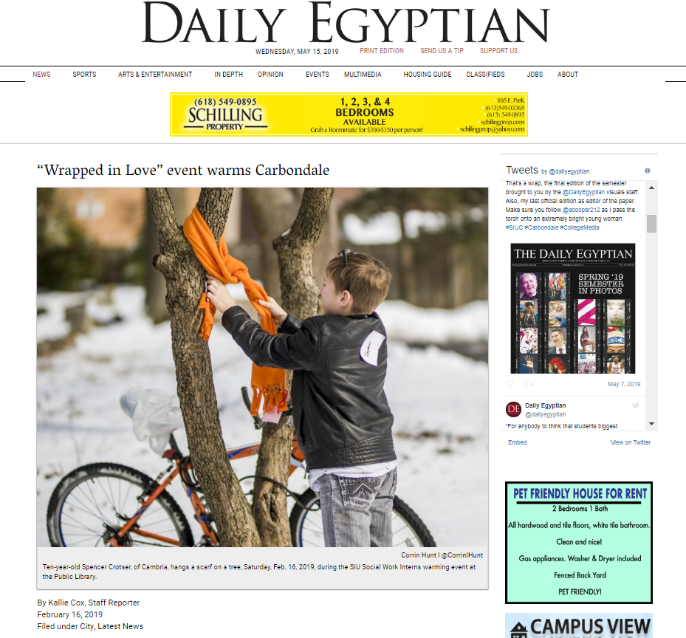
No Sew
Scarves

Slide 32
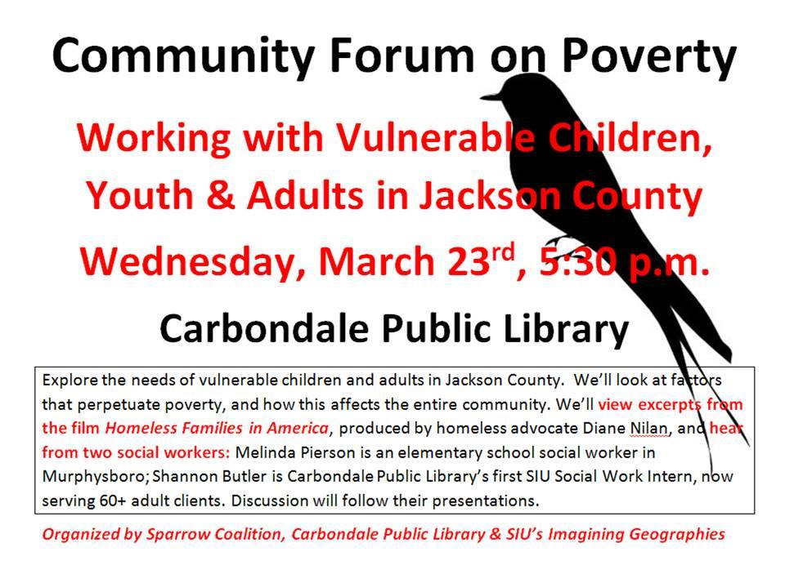
Programs

Slide 33
Information Resources

Slide 34


Slide 35
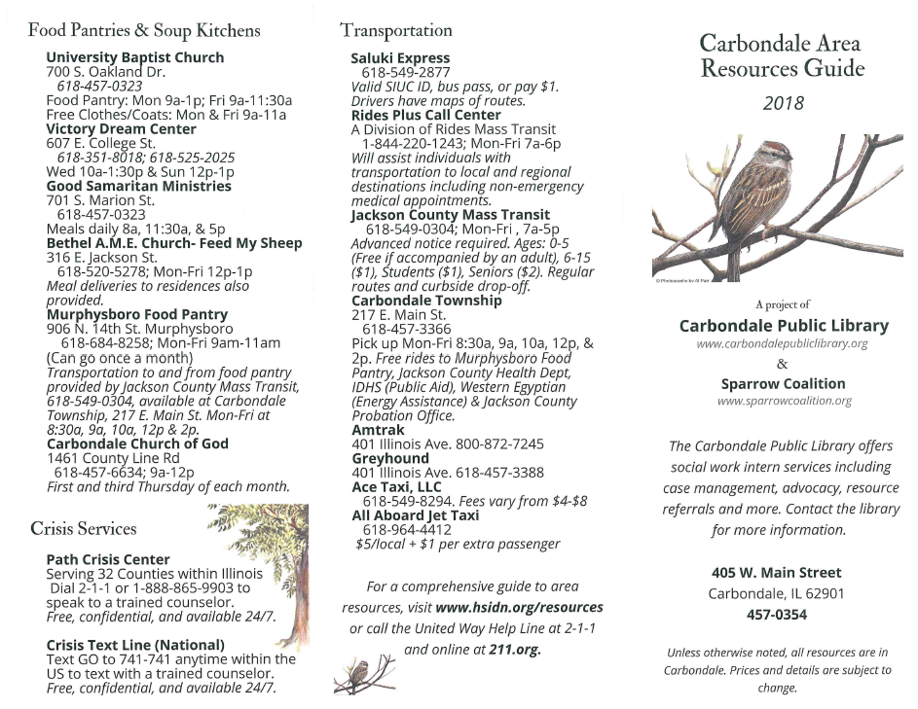

Slide 36
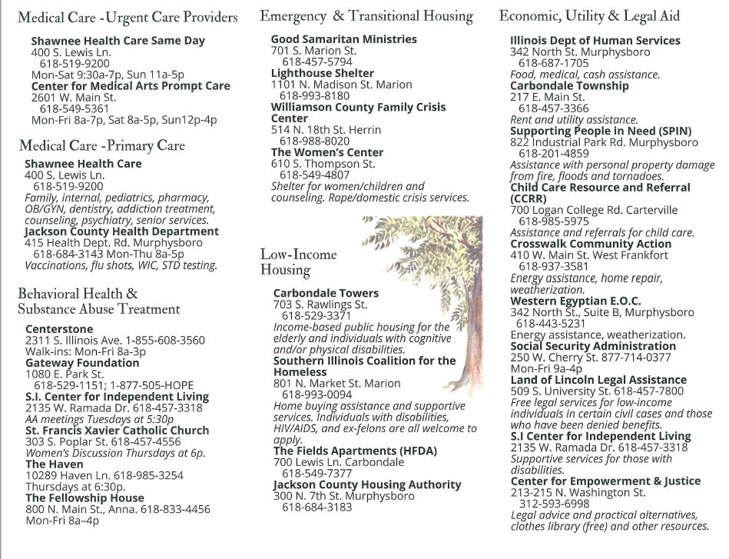

Slide 37
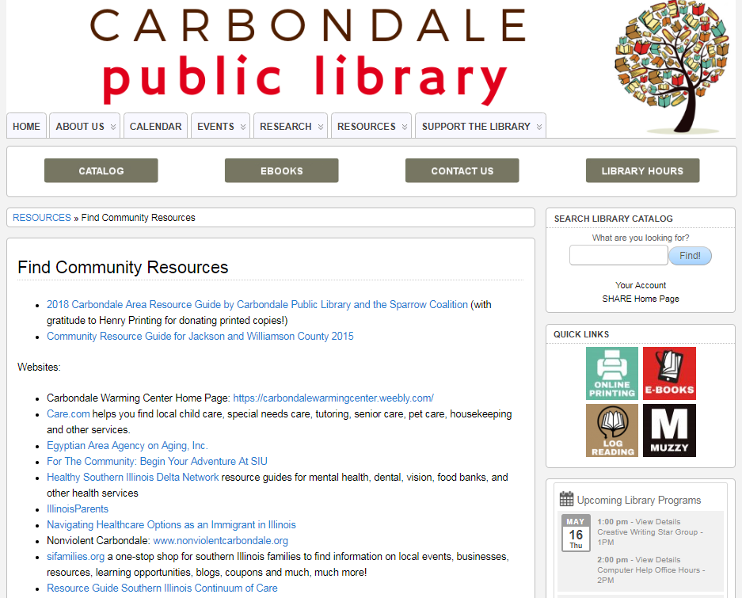
http://carbondalepubliclibrary.org/resources/find-community-resources/

Slide 38
Coalitions
&
Committees

Slide 39
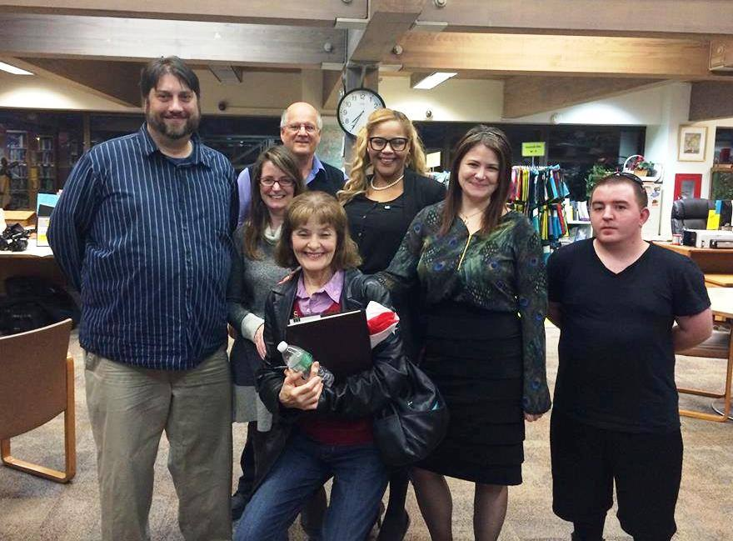
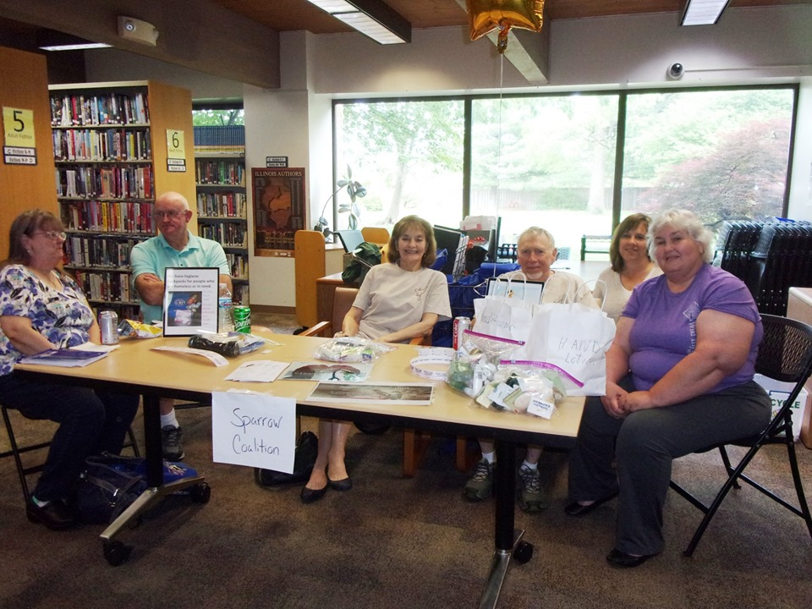
Sparrow Coalition
Examines & communicates
local service needs
Raises funds for area
service providers
Collects & distributes
hygiene bags & other items
Helps to create & distribute
resource brochures
Advocates & shares ideas
Provides cots for Warming
Center
Representatives serve on
Warming Center Committee &
volunteer at Warming Center

Slide 40
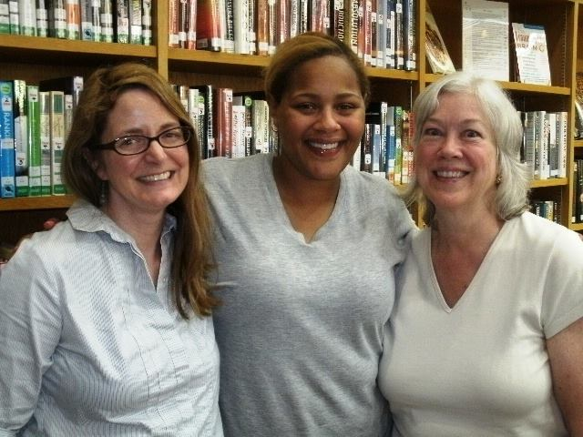
The Idea-Generating Power of a Coalition
Carbondale Public Library Director Diana Brawley Sussman
Carbondale PL’s First Social Work Intern Shannon Butler
SIU School of Social Work Professor Dona Reese
Served on the Sparrow Coalition together in 2015
and identified the opportunity to place MSW student interns in the library

Slide 41
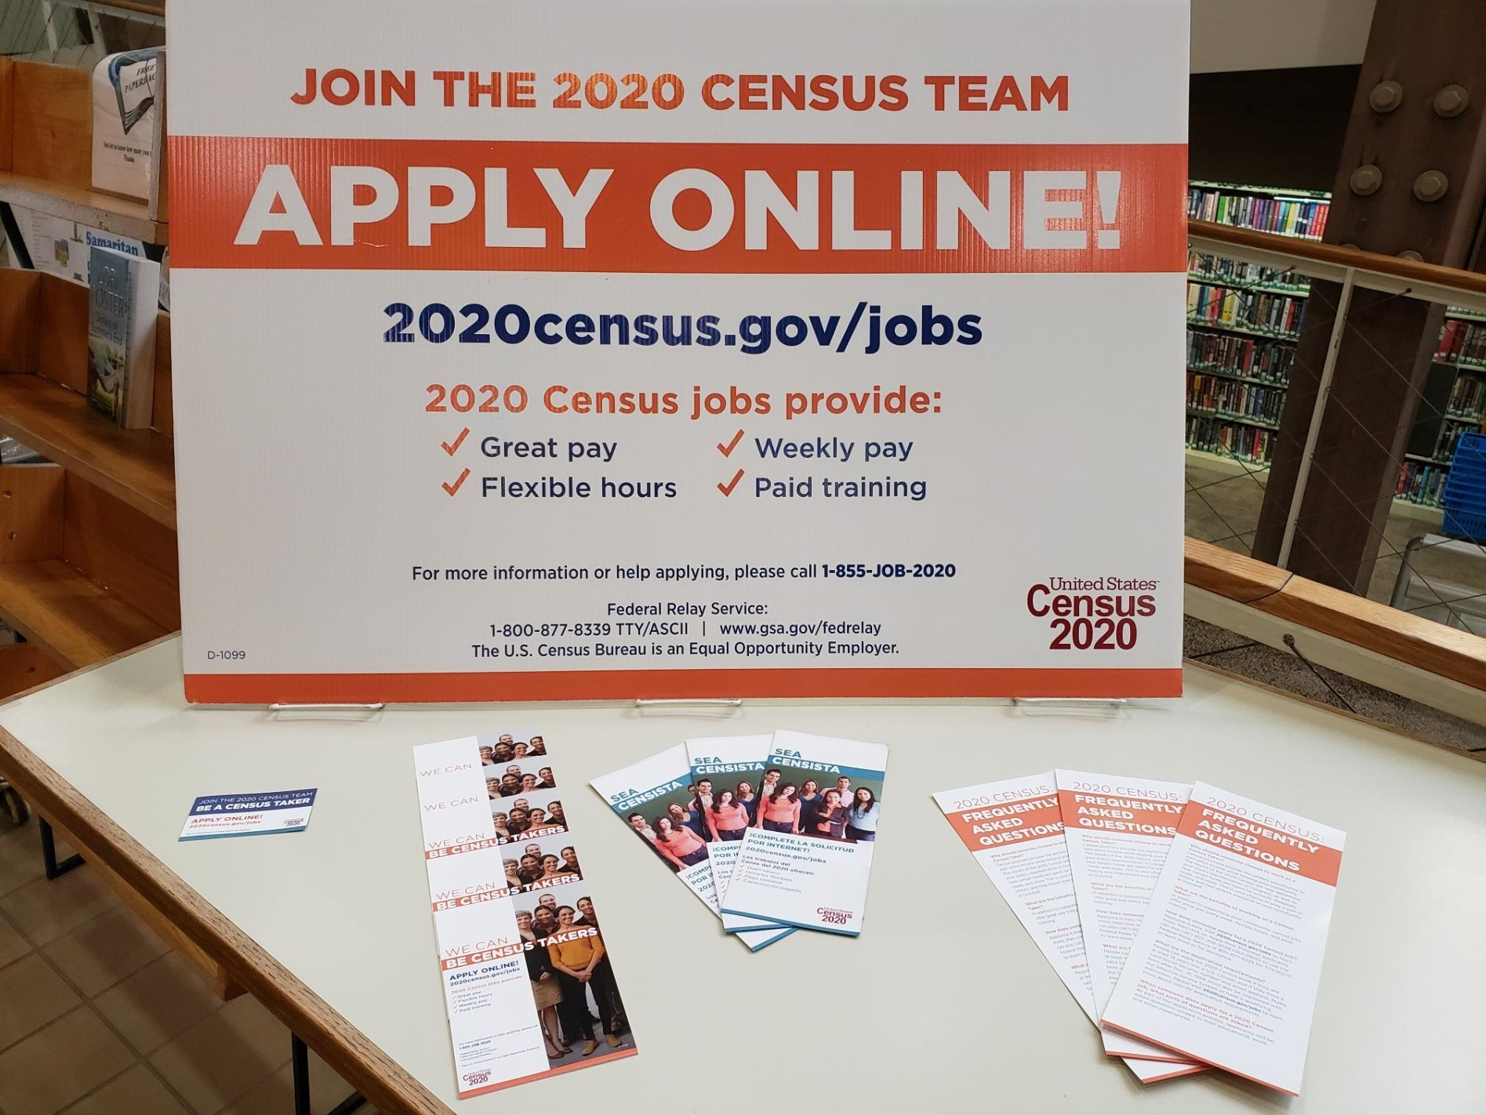
Complete Count Census Committee

Slide 42
Other Committees:
Nonviolent Carbondale
Southern Illinois Healthcare Community Benefits Advisory Committee
Positive Youth Development Coalition of the Jackson County Healthy Communities Coalition
Leadership Carbondale Planning Committee

Slide 43
Supporting
Local
Nonprofits
& Businesses

Slide 44
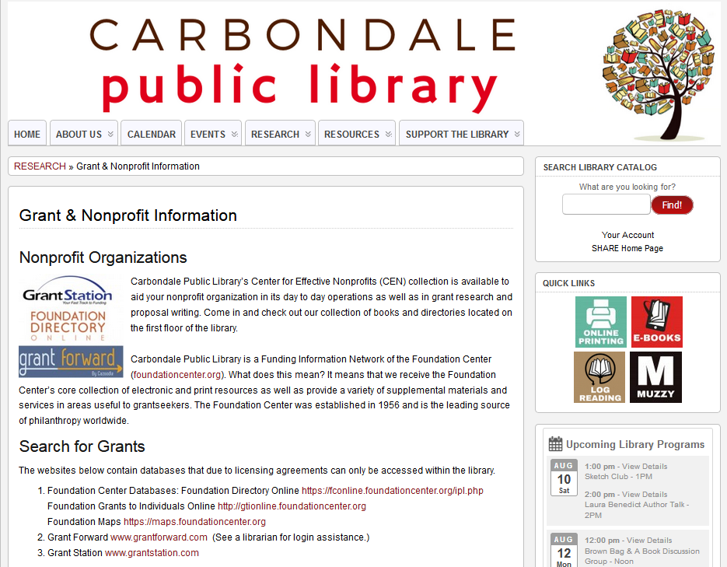

Slide 45

Mount Prospect Entrepreneurs Initiative (MPEI)
The Mount Prospect Entrepreneurs Initiative (MPEI) is a partnership between the Village of Mount Prospect, the Mount Prospect Chamber of Commerce, and the Mount Prospect Public Library whose main focus is to support and promote businesses and encourage entrepreneurship in the Village of Mount Prospect.
Slide provided by Joe Collier, Business Reference Librarian
Mount Prospect Public Library
Notes:
-create the MPEI, grew out of conversation with Mayor at Chamber Business Breakfast
-May not be the Village or Chamber for you--SBDC/SCORE/networking groups--find your partners and how you mesh to achieve the common goals.

Slide 46

Building Up the Toolbox
Business web resources
Business Insights: Global
Contains market research reports, case studies, industry profiles, and more
EZ Select
Research U.S. manufacturers in Illinois, Wisconsin, Indiana, Michigan, and Ohio
DemographicsNow
Demographic data, ideal for gaining consumer and market insight
Gale Small Business Builder
Helps entrepreneurs/small business owners/nonprofits create a professional business plan
Mergent Intellect
Company facts on over 20 million North American companies & over 70 million global companies w/ industry reports from First Research & Key Business Ratios
Small Business Resource Center
Covers all major areas of starting and operating a business
Foundation Directory Online
Information on more than 140,000 grant makers
AtoZ Databases
30 million business and executive profiles, over 220 million residents, 7 million real-time job listings
Slide provided by Joe Collier, Business Reference Librarian
Mount Prospect Public Library
Notes:
Added GSBB, DemNow, GSBC, Mergent Intellect to add to toolbox
Increased presence of nonprofit resources based on community input/trends/(GSBB)

Slide 47

Reference By Appointment (RBA)
2016: 34% of Total RBA
2017: 46% of Total RBA
2018: 25% of Total RBA
Slide provided by Joe Collier, Business Reference Librarian
Mount Prospect Public Library
Notes:
Always emphasized RBA, more push as add web resources
Adding new databases increased RBA’s, demonstrate how to use, repeat appts, business library card for office use

Slide 48
“I believe that public libraries
are uniquely positioned to create
environments that foster
community change.”
-- Brian Shepard
Executive Director
Indian Trails Public Library
& 2019 Illinois
Librarian
of the Year
on “Why I Turn Outward”
theharwoodinstitute.org

Slide 49
Questions?
Diana Brawley Sussman, Director
Carbondale Public Library
405 W. Main St.
Carbondale, IL 62901
Phone: 618-457-0354, ext. 9
Fax: 618-457-0353
Email: dbrawley@carbondale.lib.il.us
Web: www.carbondalepubliclibrary.org
"Carbondale Public Library provides resources and services to support the educational, informational, cultural, and recreational needs of its community."

